Slide 1
Do now
Find the mean, median, mode and range:
1, 4, 5, 12, 14, 3, 17, 20, 21, 1, 4, 2, 7, 13
2. Name 4 types of continuous data
3. Name 4 types of discrete data
Reminders:
Books out
Pens out
Whiteboard
Phones away
Bags on floor
Reminders
Assessment: Start today and write up next week

Slide 2
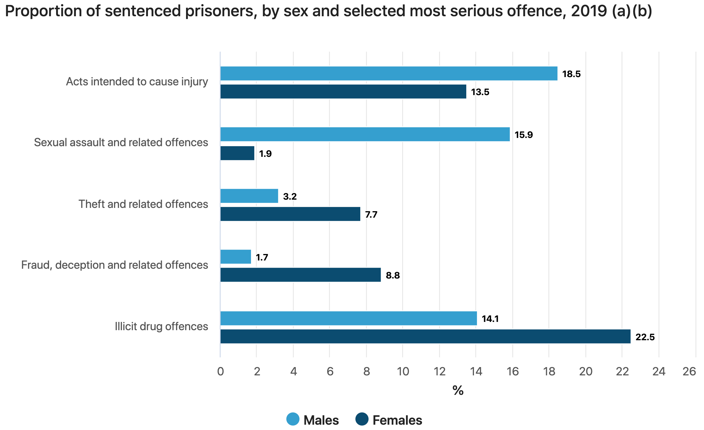
Do now
Reminders:
Phones away
Bags on floor
Books out
Pens out
1. Describe three findings from the above data set (3 marks)
2. What type of data is the above graph depicting (1 mark)

Slide 3
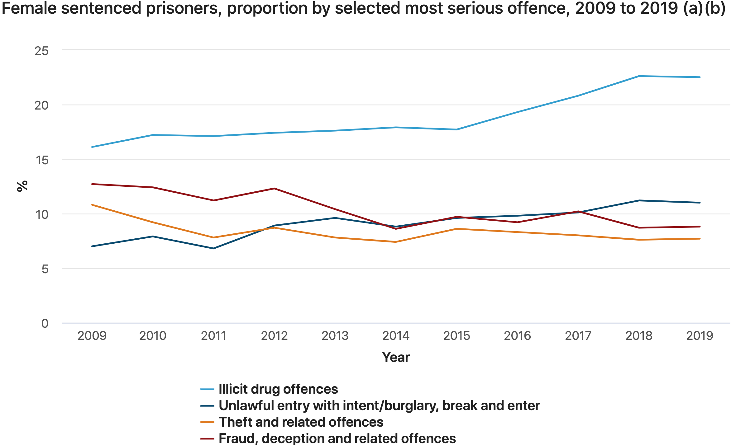
Do now
Reminders:
Phones away
Bags on floor
Books out
Pens out
Whiteboard
1. Describe two findings from the above data set (2 marks)
2. Describe a trend from the above data set (1 mark)

Slide 4
Do now
Thumbs up thumbs down
True or False
Extraneous variables are what researchers try to control for
The independent variable is what what is being measured
On a graph the independent variable goes on the Y axis
Reliability is the same as validity
Validity is how well controlled the variable were
Reminders:
Phones away
Bags on floor
Books out
Pens out
Whiteboard
Reminders
Assessment: Start today and write up next week

Slide 5
Active prior knowledge
What participant rights do you remember?
Why do researchers have ethics in research?
Be prepared to share
Notes:
Teacher questions:
What are the three divisions of the brain?
What is the oldest part of the brain?

Slide 6

Learning Intention
By the end of the lesson I will be able to:
Collect the data for the investigation
Write notes for my method section
Describe the key terms for my investigation and the introduction section
Success Criteria
Everyone
Participated in the investigation and completed the survey
Peer reviewed someone else's method section

Slide 7
STEP 1: Participant briefing
Thank you for taking part in this research and for signing the consent forms*
Your data will be kept anonymous at all times
If you feel you need to leave the experiment please inform the researcher at any time**
The aim of this investigation is to investigate group dynamics under competition
Step 2: Move to your assigned team
and brainstorm ideas for your structure.
I will pick out and brief the leaders
* No consent form really needed as this is a learning activity and not real publishable research
** haha kidding you can’t leave ☺ love you all

Slide 8
GOAL: BUILD THE TALLEST FREE STANDING TOWER
Instructions:
1. You will be randomly allocated into one of three groups
2. One from each group will be randomly selected as the "leader" - you may tell the group if you are a leader or a member only
3. You will each come to get 25 straws and 1.5 meters of tape and one pair of scissors
4. Each group gets 3 minutes of brainstorming time to plan how they will create their structure
5. Each group will then compete to create the highest structure in 10 minutes
6. After 15 minutes the tallest structure will be assessed and win
7. Fill out the survey about the task immediately after - in silence
Investigation

Slide 9
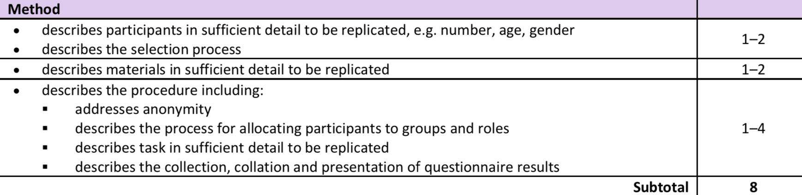
Method
Skill development
Step 1
Identify participants (how many? Who are they/demographic information)
Identify sampling method
Explain why sampling method was used
Identify participant allocation
Explain why participant allocation was used

Slide 10
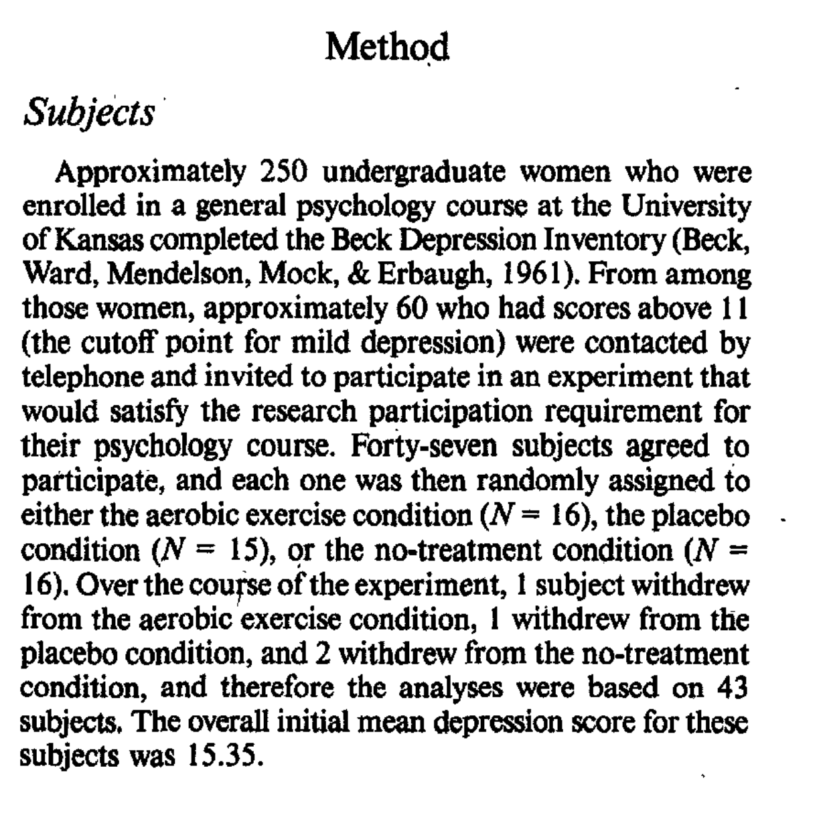

Method
Example of Step 1:
Skill development

Slide 11
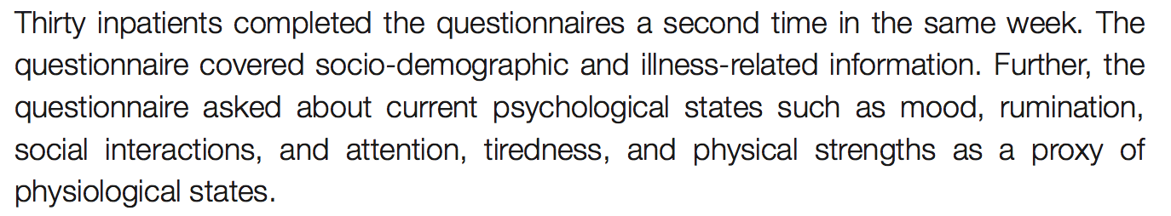
Method
Skill development
Step 2
Identify the materials used in the investigation
Explain why materials were used

Slide 12
Method
Skill development
Step 4
Provide a step-by-step guide on the procedure of the investigation
Sentence starters:
Firstly the researchers briefed participants on the aim that…..
Then the researchers handed out the questionnaire that measured…
Participants anonymity was maintained through…

Slide 13
Method
Skill development
Step 5
Identify possible extraneous variables.
Explain how extraneous variables are being controlled for.
Vocabulary
Extraneous variables: variables that the researchers tries to control for, so they do not influence the dependent variable (they are not being studied in the experiment).

Slide 14
Research task
Concept Development
Research the 3 leadership styles:
Autocratic
Democratic
Laisse-faire
You will need to be able to describe it and the outcomes each leadership style has on group outcomes and productivity.
Use the links on SEQTA

